Slide 1
library story
Xujian Zhang

Slide 2
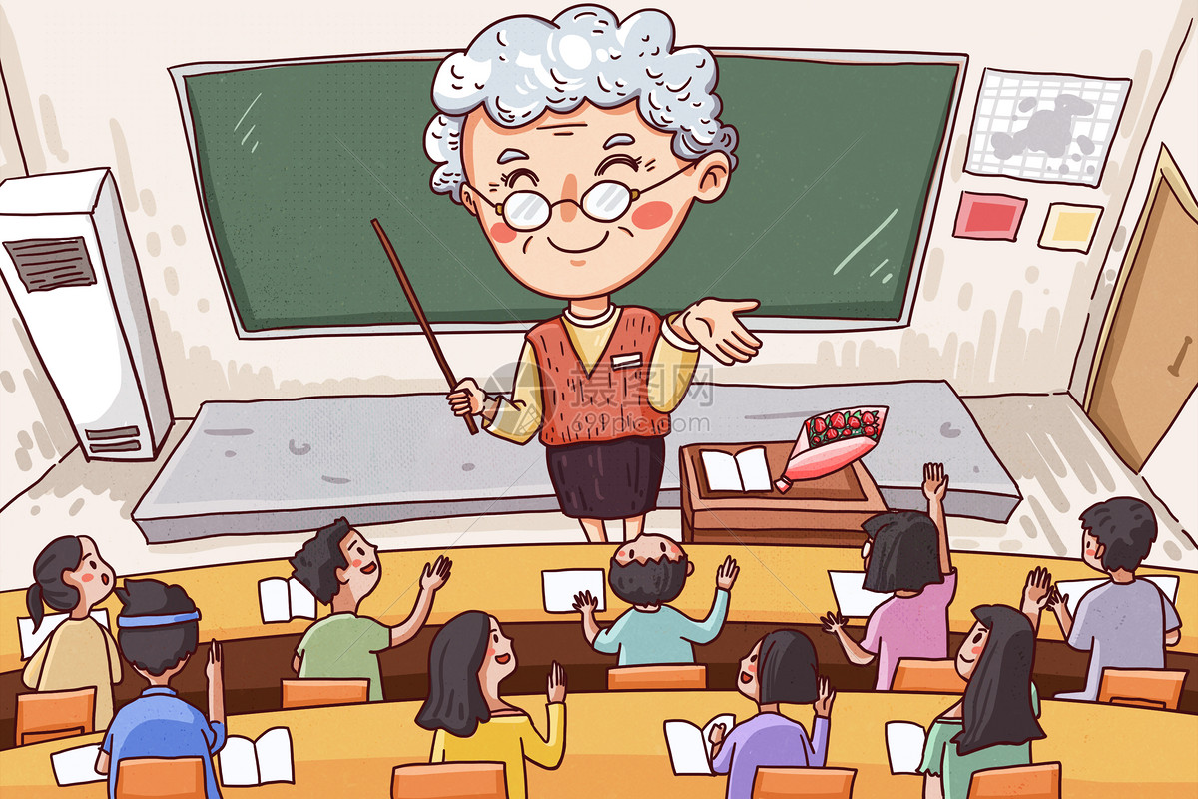
library story
I want to tell you a college professor, Steve, who runs into trouble every year before starting school. Because computer technology is constantly improving, Steve tries to add new content to his teaching every year.

Slide 3

library story
However, due to the size of the university library. Very small, unable to provide enough books and paper for Steve.

Slide 4
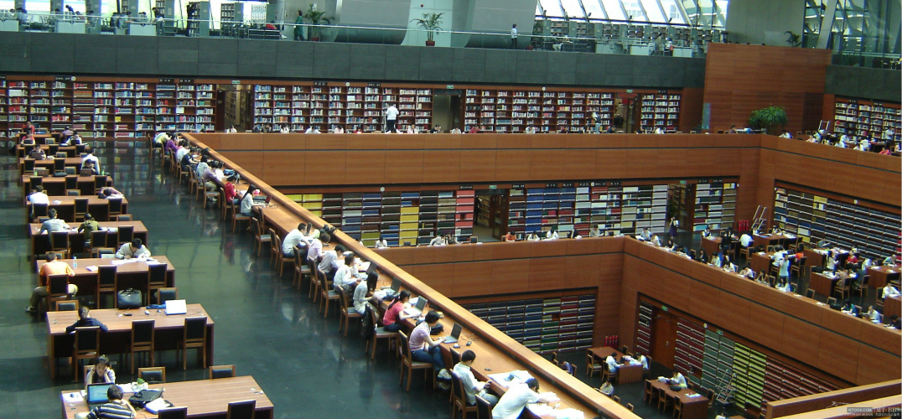
library story
So he needs to go to Beijing to visit the National Library every year before the start of school, and spend a week to improve his lesson plans.

Slide 5
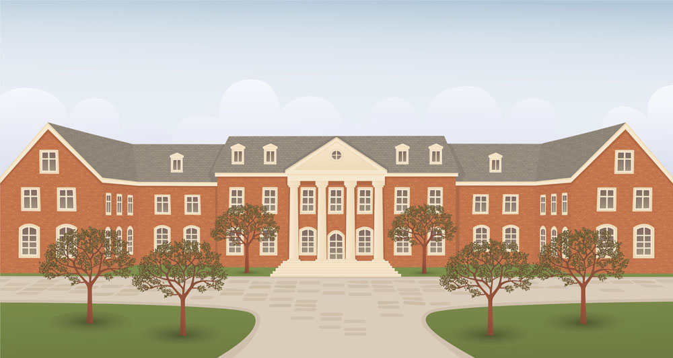
library story
Because the professor is old, the dean of the college is Apply to the National Library, hope that the library can provide them with enough books and papers.

Slide 6
Thank you!

